Slide 1
Covalent substances
COVALENT MOLECULAR SUBSTANCES

Slide 2
COVALENT MOLECULAR SUBSTANCES
COVALENT MOLECULAR SUBSTANCES ARE FORMED WHEN NEIGHBOURING ATOMS SHARE ELECTRONS
Like ionic substances they try to obey the octet rule – attain 8 outer (valence) electrons
covalent molecular bonding occurs in non-metal elements & non-metal compounds

Slide 3

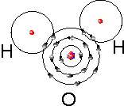
hydrogen
water

Slide 4
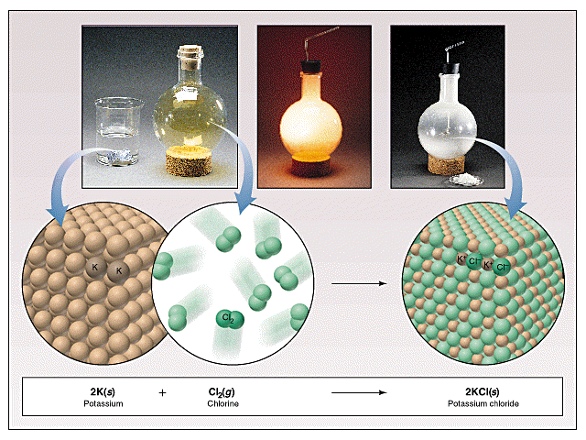
Although the bonding within the molecules is strong, the forces of attraction between them is not. hence Covalent molecular substances have low melting & boiling points.
This is why most of them are gases or liquids.
Eg. Chlorine gas
Cl₂

Slide 5




Other examples
HCl
Hydrogen Chloride
CO₂
Carbon dioxide
NH₃
Ammonia
CH₄
Methane

Slide 6
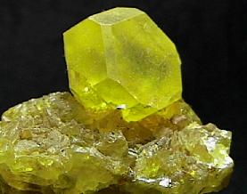
Sulfur is a solid but has a low melting point– 120ºc
Sulfur – S₈ Italy

Slide 7
S
S
S
S
S
S
S
S
Sulfur forms S₈ rings
Each sulfur in the ring forms a single bond with each of its neighbours
S S S

Slide 8
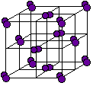
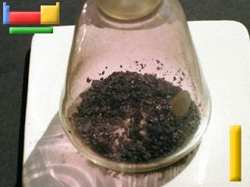
I I
Iodine I₂ is also a covalent molecular solid
On heating it easily sublimes I_{2(s) }’  I_{2(g)}
WHY? Weak forces between molecules.

Slide 9
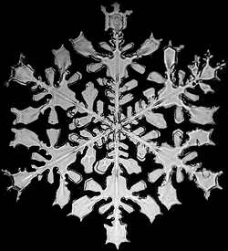
Water also has a low boiling & melting point
Because of weak intermolecular forces
O H
H
When it cools sufficiently its molecules slow and these weak forces can then pull the molecules into formation in ice crystals

Slide 10





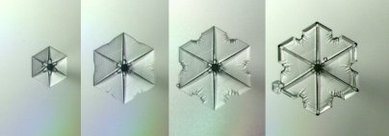
pretty
The
end
Aren’t they?

